Slide 1
CONVOLUTIONAL NEURAL NETWORK
MODULE 3

Slide 2
INTRODUCTION
A Convolutional Neural Network (CNN) is a type of Deep Learning neural network architecture commonly used in Computer Vision.
Computer vision is a field of Artificial Intelligence that enables a computer to understand and interpret the image or visual data.
We use CNN for image classification.
CNN’s are a special type of ANN which accepts images as inputs.

Slide 3
Why CNN?
Talking about grayscale images, they have pixel ranges from 0 to 255 i.e. 8-bit pixel values. If the size of the image is NxM, then the size of the input vector will be N*M. For RGB images, it would be N*M*3. Consider an RGB image with size 30x30. This would require 2700 neurons. An RGB image of size 256x256 would require over 100000 neurons.

Slide 4
The number of weights, parameters for 224x224x3 is very high.
A single neuron in the output layer will have 224x224x3 weights coming into it.
This would require more computation, memory, and data.
Each layer performs convolution on CNN.
CNN takes input as an image volume for the RGB image.
Basically, an image is taken as an input and we apply kernel/filter on the image to get the output.
CNN also enables parameter sharing between the output neurons which means that a feature detector (for example horizontal edge detector) that’s useful in one part of the image is probably useful in another part of the image.

Slide 5
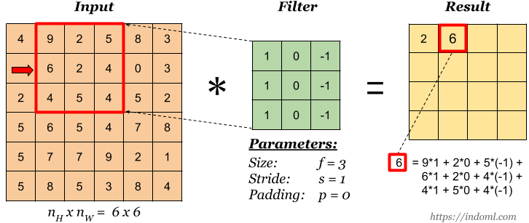
Convolutions
Every output neuron is connected to a small neighborhood in the input through a weight matrix also referred to as a kernel or a weight matrix. We can define multiple kernels for every convolution layer each giving rise to an output. Each filter is moved around the input image. The outputs corresponding to each filter are stacked giving rise to an output volume.

Slide 6
Padding
Padded convolution is used when preserving the dimension of an input matrix that is important to us and it helps us keep more of the information at the border of an image.
We have seen that convolution reduces the size of the feature map.
To retain the dimension of feature map as that of an input map, we pad or append the rows and column with zeros.
Padding P=(F-1)/2
    F is the size of the kernel matrix

Slide 7
Stride
Stride refers to the number of pixels the kernel filter will skip i.e pixels/time.
A Stride of 2 means the kernel will skip 2 pixels before performing the convolution operation.

Slide 8
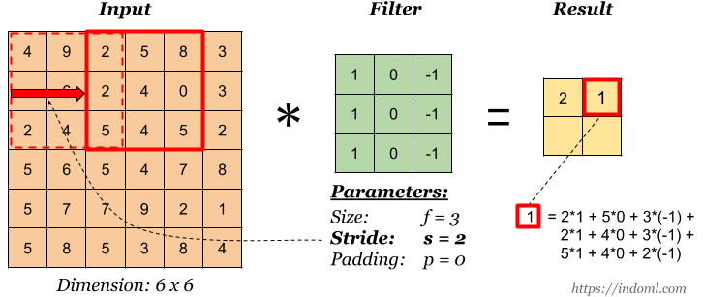
In the figure above, the kernel filter is sliding over the input matrix by skipping one pixel at a time. A Stride of 2 would perform this skipping action twice before performing the convolution like in the image below.

Slide 9
The output feature map is reduced(4 times) when the stride is increased from 1 to 2.
The dimension of the output feature map is (N-F)/S + 1.

Slide 10
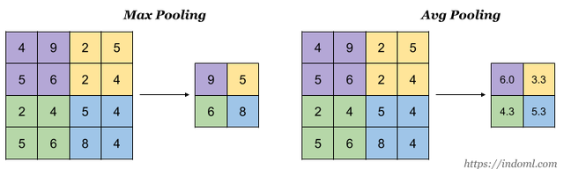
Pooling
Pooling provides translational invariance by subsampling: reduces the size of the feature maps. The two commonly used Pooling techniques are max pooling and average pooling.

Slide 11
The pooling operation divides 4x4 matrix into 4 2x2 matrices and picks the value which is the greatest amongst the four(for max-pooling) and the average of the four( for average pooling).
This reduces the size of the feature maps which therefore reduces the number of parameters without missing important information.
One thing to note here is that the pooling operation reduces the Nx and Ny values of the input feature map but does not reduce the value of Nc (number of channels).
Also, the hyperparameters involved in pooling operation are the filter dimension, stride, and type of pooling(max or avg).
There is no parameter for gradient descent to learn.

Slide 12
Output Feature Map
The size of the output feature map or volume depends on:
Size of the input feature map
Kernel size(Kw,Kh)
Zero padding
Stride(Sw, Sh)

Slide 13
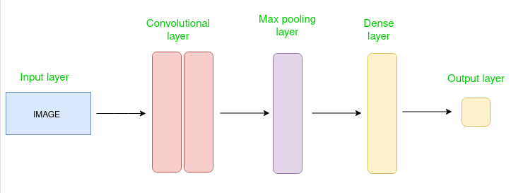
CNN architecture
Convolutional Neural Network consists of multiple layers like the input layer, Convolutional layer, Pooling layer, and fully connected layers.

Slide 14
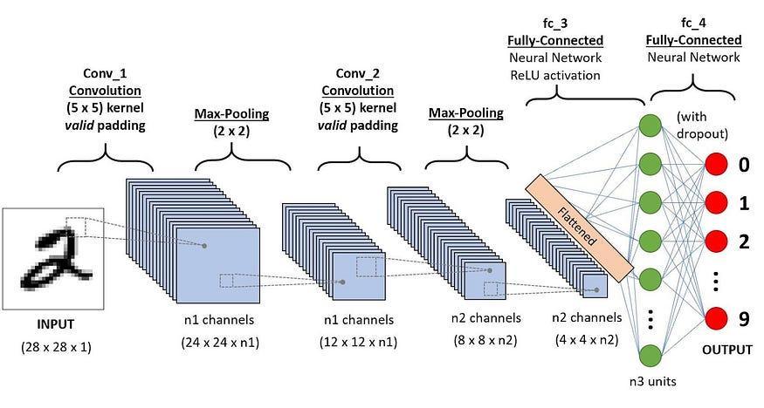

Slide 15
CNN is very useful as it minimises human effort by automatically detecting the features. For example, for apples and mangoes, it would automatically detect the distinct features of each class on its own.

Slide 16
BASIC ARCHITECTURE
There are two main parts to a CNN architecture
A convolution tool that separates and identifies the various features of the image for analysis in a process called as Feature Extraction.
The network of feature extraction consists of many pairs of convolutional or pooling layers.
A fully connected layer that utilizes the output from the convolution process and predicts the class of the image based on the features extracted in previous stages.
This CNN model of feature extraction aims to reduce the number of features present in a dataset. It creates new features which summarises the existing features contained in an original set of features. There are many CNN layers.

Slide 17
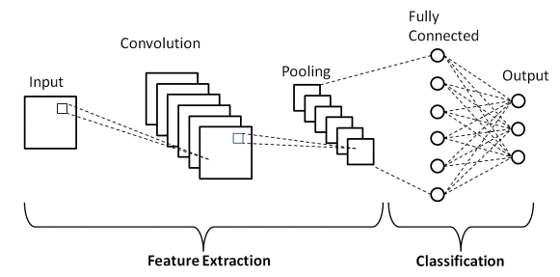

Slide 18
There are three types of layers that make up the CNN which are the convolutional layers, pooling layers, and fully-connected (FC) layers. When these layers are stacked, a CNN architecture will be formed. In addition to these three layers, there are two more important parameters which are the dropout layer and the activation function.

Slide 19
1. Convolutional Layer
This layer is the first layer that is used to extract the various features from the input images. In this layer, the mathematical operation of convolution is performed between the input image and a filter of a particular size MxM. By sliding the filter over the input image, the dot product is taken between the filter and the parts of the input image with respect to the size of the filter (MxM).
The output is termed as the Feature map which gives us information about the image such as the corners and edges. Later, this feature map is fed to other layers to learn several other features of the input image.
The convolution layer in CNN passes the result to the next layer once applying the convolution operation in the input.

Slide 20
2. Pooling Layer
In most cases, a Convolutional Layer is followed by a Pooling Layer. The primary aim of this layer is to decrease the size of the convolved feature map to reduce the computational costs.
Depending upon method used, there are several types of Pooling operations.
It basically summarizes the features generated by a convolution layer.
In Max Pooling, the largest element is taken from feature map. Average Pooling calculates the average of the elements in a predefined sized Image section. The total sum of the elements in the predefined section is computed in Sum Pooling. The Pooling Layer usually serves as a bridge between the Convolutional Layer and the FC Layer.
This CNN model generalises the features extracted by the convolution layer, and helps the networks to recognise the features independently.
With the help of this, the computations are also reduced in a network.

Slide 21
3. Fully Connected Layer
The Fully Connected (FC) layer consists of the weights and biases along with the neurons and is used to connect the neurons between two different layers. These layers are usually placed before the output layer and form the last few layers of a CNN Architecture.
In this, the input image from the previous layers are flattened and fed to the FC layer. The flattened vector then undergoes few more FC layers where the mathematical functions operations usually take place. In this stage, the classification process begins to take place. The reason two layers are connected is that two fully connected layers will perform better than a single connected layer. These layers in CNN reduce the human supervision

Slide 22
4. Dropout
Usually, when all the features are connected to the FC layer, it can cause overfitting in the training dataset. Overfitting occurs when a particular model works so well on the training data causing a negative impact in the model’s performance when used on a new data.
To overcome this problem, a dropout layer is utilised wherein a few neurons are dropped from the neural network during training process resulting in reduced size of the model. On passing a dropout of 0.3, 30% of the nodes are dropped out randomly from the neural network.
Dropout results in improving the performance of a machine learning model as it prevents overfitting by making the network simpler. It drops neurons from the neural networks during training.

Slide 23
5. Activation Functions
Finally, one of the most important parameters of the CNN model is the activation function.
They are used to learn and approximate any kind of continuous and complex relationship between variables of the network.
In simple words, it decides which information of the model should fire in the forward direction and which ones should not.
It adds non-linearity to the network.
There are several commonly used activation functions such as the ReLU, Softmax, tanH and the Sigmoid functions.
Each of these functions have a specific usage.
For a binary classification CNN model, sigmoid and softmax functions are preferred an for a multi-class classification, generally softmax us used.
In simple terms, activation functions in a CNN model determine whether a neuron should be activated or not.
It decides whether the input to the work is important or not to predict using mathematical operations.

Slide 24
LeNet-5 CNN Architecture
In 1998, the LeNet-5 architecture was introduced in a research paper titled “Gradient-Based Learning Applied to Document Recognition” by Yann LeCun, Leon Bottou, Yoshua Bengio, and Patrick Haffner. It is one of the earliest and most basic CNN architecture.
It consists of 7 layers. The first layer consists of an input image with dimensions of 32×32. It is convolved with 6 filters of size 5×5 resulting in dimension of 28x28x6. The second layer is a Pooling operation which filter size 2×2 and stride of 2. Hence the resulting image dimension will be 14x14x6.
Similarly, the third layer also involves in a convolution operation with 16 filters of size 5×5 followed by a fourth pooling layer with similar filter size of 2×2 and stride of 2. Thus, the resulting image dimension will be reduced to 5x5x16.
Once the image dimension is reduced, the fifth layer is a fully connected convolutional layer with 120 filters each of size 5×5. In this layer, each of the 120 units in this layer will be connected to the 400 (5x5x16) units from the previous layers. The sixth layer is also a fully connected layer with 84 units.
The final seventh layer will be a softmax output layer with ‘n’ possible classes depending upon the number of classes in the dataset

Slide 25
Advantages of Convolutional Neural Networks (CNNs):
Good at detecting patterns and features in images, videos, and audio signals.
Robust to translation, rotation, and scaling invariance.
End-to-end training, no need for manual feature extraction.
Can handle large amounts of data and achieve high accuracy.
Disadvantages of Convolutional Neural Networks (CNNs):
Computationally expensive to train and require a lot of memory.
Can be prone to overfitting if not enough data or proper regularization is used.

Slide 26

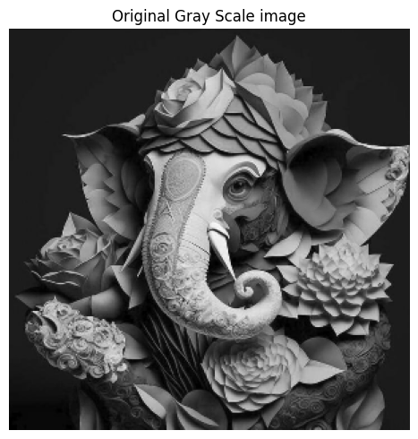
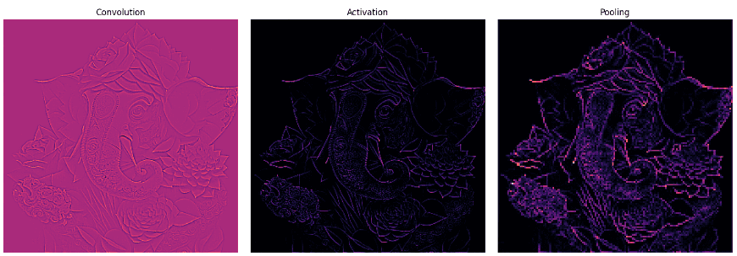

Slide 27
CASE STUDIES OF CONVOLUTIONAL ARCHITECTURE
ALEXNET
AlexNet comprises 8 layers — out of which 5 are convolutional and 3 denotes fully-connected. A couple of more layers were stacked onto LeNet 5, hence forming AlexNet as demonstrated in Figure. This architecture was the first to carry out ReLU activation function and utilized Dropout layers.The architecture uses 60,000 parameters.

Slide 28
Advantages:
The model performed classification of images efficiently.
The computation performed is fast.
More computation and memory efficiency
It is robust
Disadvantages:
They are difficult in application of high resolution images

Slide 29
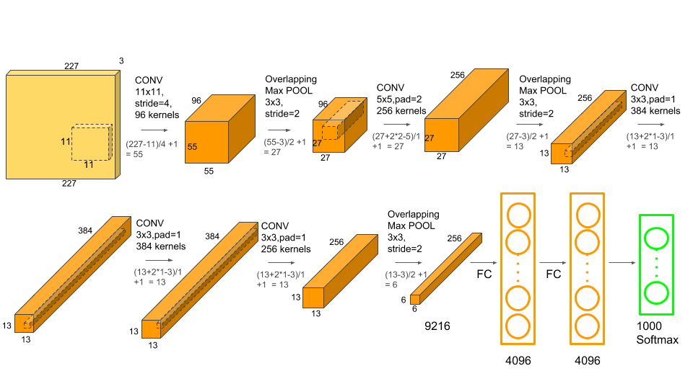

Slide 30
The first two fully-connected layers have 4096 nodes each. After the above mentioned last max-pooling, we have a total of 6*6*256 i.e. 9216 nodes or features and each of these nodes is connected to each of the nodes in this fully-connected layer. So the number of connections we'll have in this case is 9216*4096.

Slide 31
ZFNET
ZFNet came to the limelight having significant improvement over AlexNet.
This paper is the golden gem that gives you the starting point for many concepts such as deep feature visualization, feature invariance, feature evolution, and feature importance.

Slide 32
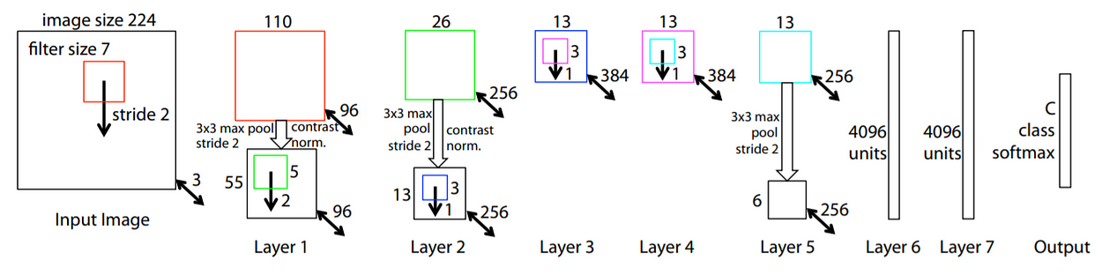

Slide 33
Our input is 224x224x3 images.
Next, 96 convolutions of 7x7 with a stride of 2 are performed, followed by ReLU activation, 3x3 max pooling with stride 2 and local contrast normalization.
Followed by it are 256 filters of 3x3 each which are then again local contrast normalized and pooled.
The third and fourth layers are identical with 384 kernels of 3x3 each.
The fifth layer has 256 filters of 3x3, followed by 3x3 max pooling with stride 2 and local contrast normalization.
The sixth and seventh layers house 4096 dense units each.
Finally, we feed into a Dense layer of 1000 neurons i.e. the number of classes in ImageNet.

Slide 34
The local normalization tends to uniformize the mean and variance of an image around a local neighborhood. This is especially useful for correct uneven illumination or shading artifacts.
Local Contrast Normalization is a type of normalization that performs local subtraction and division normalizations, enforcing a sort of local competition between adjacent features in a feature map, and between features at the same spatial location in different feature maps.

Slide 35
VGG
VGG was developed to increase the depth of such CNNs in order to increase the model performance.
VGG stands for Visual Geometry Group; it is a standard deep Convolutional Neural Network (CNN) architecture with multiple layers. The “deep” refers to the number of layers with VGG-16 or VGG-19 consisting of 16 and 19 convolutional layers.

Slide 36
VGG-16
The model VGG16 was developed by Visual Geometry Group (VGG) that comprises of 13 convolutional and 3 fully connected layers, carrying ReLu custom from AlexNet. More and more layers are stacked on AlexNet to get the VGG model.

Slide 37
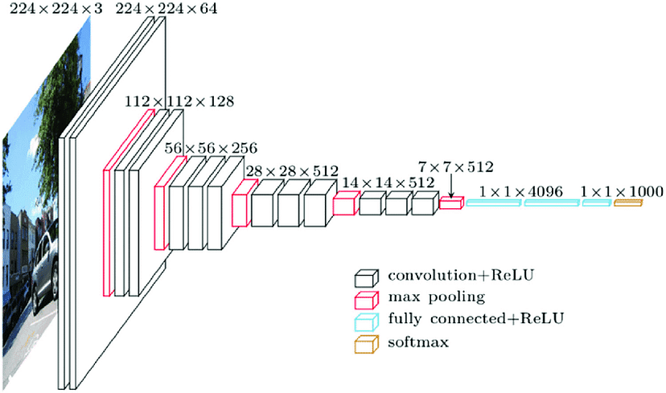

Slide 38
VGG 19
The concept of the VGG19 model (also VGGNet-19) is the same as the VGG16 except that it supports 19 layers.
The “16” and “19” stand for the number of weight layers in the model (convolutional layers).
This means that VGG19 has three more convolutional layers than VGG16.

Slide 39
VGG 19
It is a variety of VGG model that includes 19 layers (16 convolution layer, 5 MaxPool, 3 Fully related layer and 1 SoftMax layer).
Advantages:
The model is efficient in performing transfer learning and small classification tasks.
It is more robust
Disadvantages:
Due to the use of large no of parameters i.e 138 million parameters, it will increase the computation cost
The model isn’t useful for deep networks as more the deeper it goes, it is more inclined to Vanishing Gradients Problem.

Slide 40
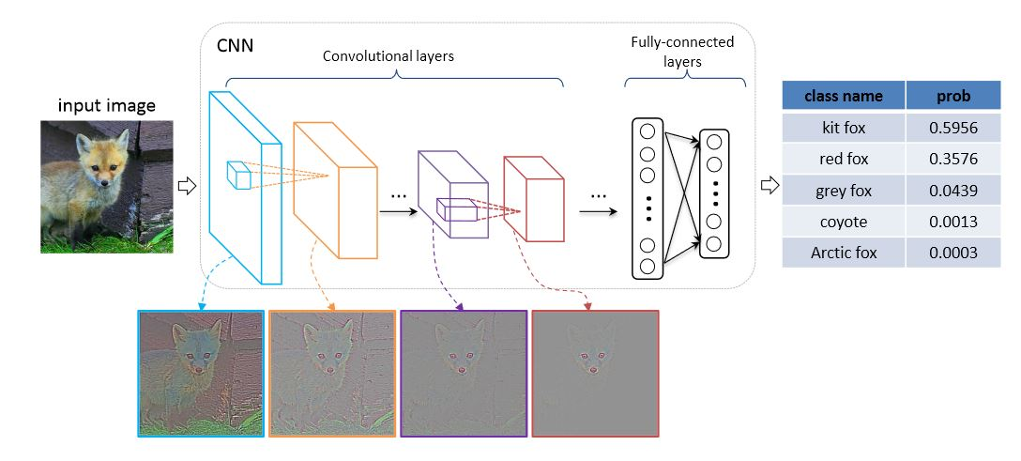

Slide 41
Input: The VGGNet takes in an image input size of 224×224.
Convolutional Layers: VGG’s convolutional layers leverage a minimal receptive field, i.e., 3×3, the smallest possible size that still captures up/down and left/right.
Hidden Layers: All the hidden layers in the VGG network use ReLU. VGG does not usually leverage Local Response Normalization (LRN) as it increases memory consumption and training time. Moreover, it makes no improvements to overall accuracy.

Slide 42
Fully-Connected Layers: The VGGNet has three fully connected layers. Out of the three layers, the first two have 4096 channels each, and the third has 1000 channels, 1 for each class.

Slide 43
ResNet-50
ResNet stands for Residual Network and is a specific type of convolutional neural network (CNN) introduced in the 2015.
ResNet-50 is a 50-layer convolutional neural network (48 convolutional layers, one MaxPool layer, and one average pool layer).
Residual neural networks are a type of artificial neural network (ANN) that forms networks by stacking residual blocks.

Slide 44
The ResNet architecture was developed in response to a surprising observation in deep learning research: adding more layers to a neural network was not always improving the results.
This was unexpected because adding a layer to a network should allow it to learn at least what the previous network learned, plus additional information.
To address this issue, the ResNet team, led by Kaiming He, developed a novel architecture that incorporated skip connections.
These connections allowed the preservation of information from earlier layers, which helped the network learn better representations of the input data. With the ResNet architecture, they were able to train networks with as many as 152 layers.

Slide 45
ResNet-50 Architecture
ResNet-50 consists of 50 layers that are divided into 5 blocks, each containing a set of residual blocks. The residual blocks allow for the preservation of information from earlier layers, which helps the network to learn better representations of the input data.

Slide 46
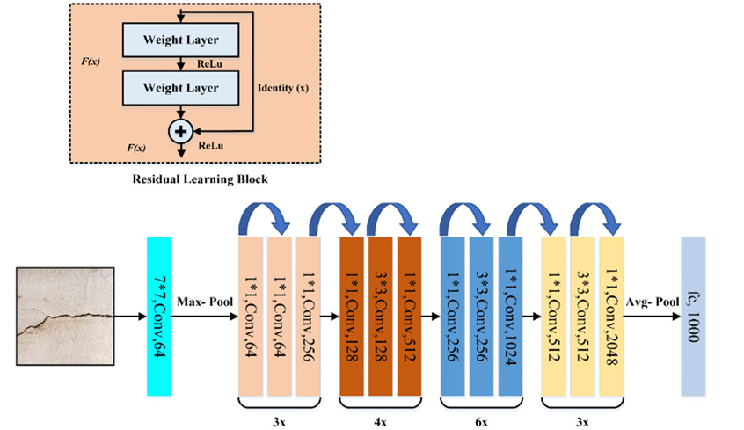

Slide 47
1. Convolutional Layers
The first layer of the network is a convolutional layer that performs convolution on the input image. This is followed by a max-pooling layer that downsamples the output of the convolutional layer. The output of the max-pooling layer is then passed through a series of residual blocks.
2. Residual Blocks
Each residual block consists of two convolutional layers, each followed by a batch normalization layer and a rectified linear unit (ReLU) activation function. The output of the second convolutional layer is then added to the input of the residual block, which is then passed through another ReLU activation function. The output of the residual block is then passed on to the next block.

Slide 48
3. Fully Connected Layer
The final layer of the network is a fully connected layer that takes the output of the last residual block and maps it to the output classes. The number of neurons in the fully connected layer is equal to the number of output classes.
Concept of Skip Connection
Skip connections, also known as identity connections, are a key feature of ResNet-50.
They allow for the preservation of information from earlier layers, which helps the network to learn better representations of the input data.
Skip connections are implemented by adding the output of an earlier layer to the output of a later layer.

Slide 49
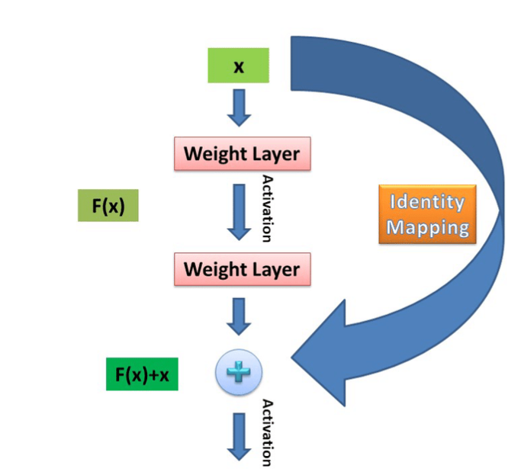

Slide 50
Advantages:
The training process is fast
Minimized vanishing gradient problem
It can train deeper networks
ResNet-50 has several advantages over other networks. One of the main advantages is its ability to train very deep networks with hundreds of layers.
This is made possible by the use of residual blocks and skip connections, which allow for the preservation of information from earlier layers.
Another advantage of ResNet-50 is its ability to achieve state-of-the-art results in a wide range of image-related tasks such as object detection, image classification, and image segmentation.
Disadvantages:
The training takes a large amount of time which makes it infeasible and impractical for real world applications.

Slide 51
CONVOLUTION OPERATION
Consider an input image, we calculate the value of each and every pixel by considering the weighted sum of pixels around it.
The matrix of weights is referred to as the Kernel or Filter.

Slide 52
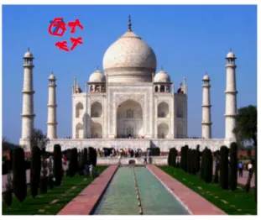
Here we are calculating the value of circled pixel considering 3 neighbors around it, assume that the weights w1, w2, w3, w4 are associated with these 4 pixels respectively

Slide 53
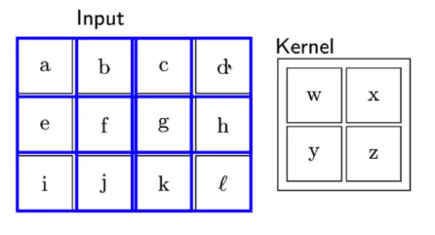
In the above case, we have the kernel of size 2X2.
Now we place the 2X2 filter over the first 2X2 portion of the image and take the weighted sum and that would give the new value of the first pixel.

Slide 54
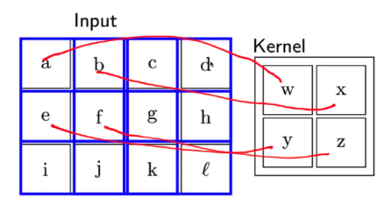

Slide 55
The output of this operation would be: (aw + bx + ey + fz)
Then we move the filter horizontally by one and place it over the next 2 X 2 portion of the input; in this case pixels of interest would be b, c, f, g and we compute the output using the same technique and we would get:

Slide 56
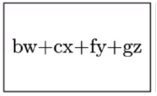
And then again we move the kernel/filter by 1 in the horizontal direction and take the weighted sum.

Slide 57
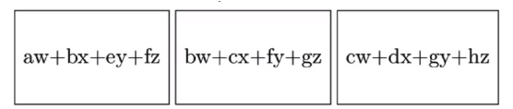
So, after this, the output from the first layer would look like:

Slide 58
Then we move the kernel by 1 down in the vertical direction, calculate the output, move the kernel in the horizontal direction and in general we move the kernel like this: first, we start off with the starting portion of the image, move the filter in the horizontal direction and cover this row completely then we move the filter in the vertical direction(by some amount respective to top left portion of image), again stride it horizontally through the entire row and continue like this. In essence, we move the kernel left to right top to bottom.

Slide 59
EXPLAIN
  PADDING
  STRIDE
  Pooling

Slide 60
Motivation for using convolution networks
🡪Convolution leverages three important ideas to improve ML systems:
1. Sparse interactions
2. Parameter sharing
3. Equivariant representations
🡪Convolution also allows for working with inputs of variable size

Slide 61
SPARSE INTERACTION
Trivial neural network layers use matrix multiplication by a matrix of parameters describing the interaction between the input and output unit.
This means that every output unit interacts with every input unit.
However, convolution neural networks have sparse interaction.
This is achieved by making kernel smaller than the input e.g., an image can have millions or thousands of pixels, but while processing it using kernel we can detect meaningful information that is of tens or hundreds of pixels.
This means that we need to store fewer parameters that not only reduces the memory requirement of the model but also improves the statistical efficiency of the model.

Slide 62
SHARED PARAMETERS
If computing one feature at a spatial point (x1, y1) is useful then it should also be useful at some other spatial point say (x2, y2).
It means that for a single two-dimensional slice i.e., for creating one activation map, neurons are constrained to use the same set of weights.
In a traditional neural network, each element of the weight matrix is used once and then never revisited, while convolution network has shared parameters i.e., for getting output, weights applied to one input are the same as the weight applied elsewhere.

Slide 63
Equivariant representations
Due to parameter sharing, the layers of convolution neural network will have a property of equivariance to translation.
It says that if we changed the input in a way, the output will also get changed in the same way.

Slide 64
Q. What happens is the stride of convolution layer increases? What can be the maximum stride? Justify
Stride is a component of convolutional neural networks, or neural networks tuned for the compression of images and video data. Stride is a parameter of the neural network's filter that modifies the amount of movement over the image or video. For example, if a neural network's stride is set to 1, the filter will move one pixel, or unit, at a time. The size of the filter affects the encoded output volume, so stride is often set to a whole integer, rather than a fraction or decimal.
Naturally, as the stride, or movement, is increased, the resulting output will be smaller.
The choice of stride is also important, but it affects the tensor shape after the convolution, hence the whole network. The general rule is to use stride=1 in usual convolutions and preserve the spatial size with padding, and use stride=2 when you want to downsample the image.

Slide 65
Tensor
Tensors represent deep learning data. They are multidimensional arrays, used to store multiple dimensions of a dataset. Each dimension is called a feature. For example, a cube storing data across an X, Y, and Z access is represented as a 3-dimensional tensor.
Tensors are multi-dimensional arrays with a uniform type used to represent different features of the data

Slide 66
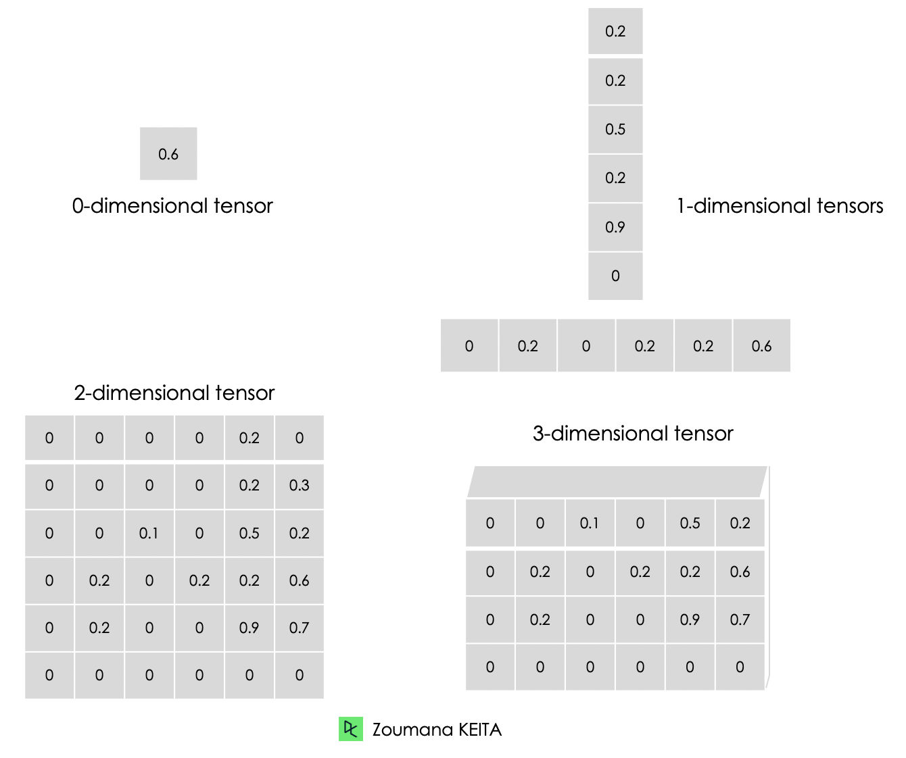
Tensor

Slide 67
Kernel Flipping
In a CNN, each filter is learned to detect a specific feature in the input image. By flipping the filter, we ensure that the filter learns to detect the same feature regardless of its position in the input image.
Downsampling
A downsampling layer helps to reduce the dimensionality of the features . This helps save computations. Average pooling, max pooling, global average pooling are some examples of downsampling layer. An alternative would be to use strides in the convolution layer to downsample.

Slide 68
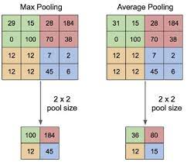

Slide 69
POOLING
The pooling operation involves sliding a two-dimensional filter over each channel of feature map and summarising the features lying within the region covered by the filter.
A common CNN model architecture is to have a number of convolution and pooling layers stacked one after the other.
Pooling layers are used to reduce the dimensions of the feature maps. Thus, it reduces the number of parameters to learn and the amount of computation performed in the network.
The pooling layer summarises the features present in a region of the feature map generated by a convolution layer.

Slide 70
Types of Pooling Layers:
🡪. Max Pooling
Max pooling is a pooling operation that selects the maximum element from the region of the feature map covered by the filter. Thus, the output after max-pooling layer would be a feature map containing the most prominent features of the previous feature map.

Slide 71
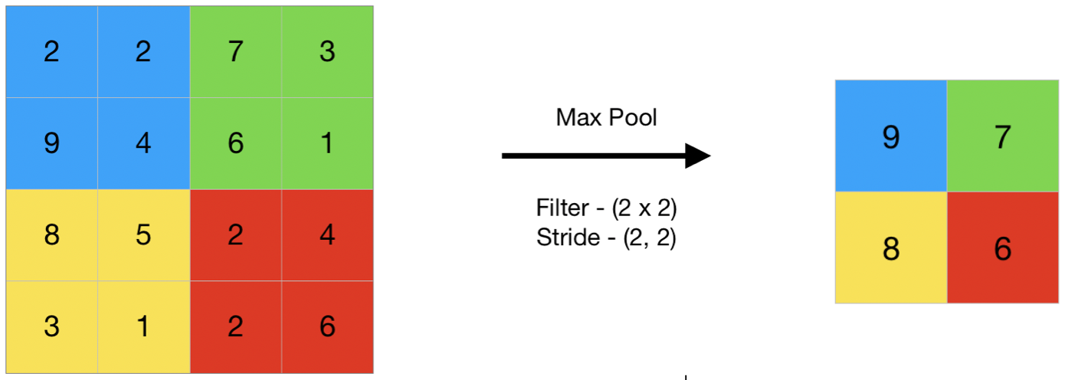

Slide 72
🡪Average Pooling
Average pooling computes the average of the elements present in the region of feature map covered by the filter. Thus, while max pooling gives the most prominent feature in a particular patch of the feature map, average pooling gives the average of features present in a patch.

Slide 73
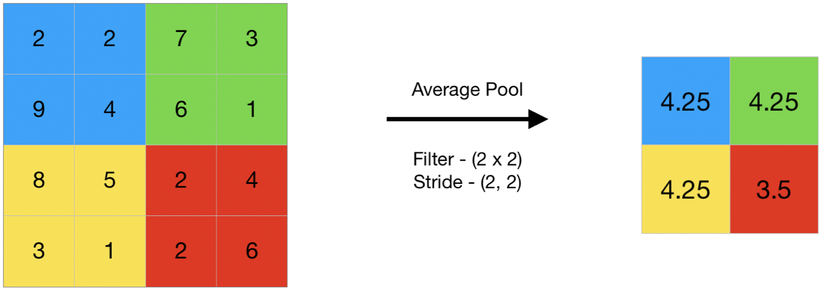

Slide 74
🡪Global Pooling
Global pooling reduces each channel in the feature map to a single value. Thus, an nh x nw x nc feature map is reduced to 1 x 1 x nc feature map. This is equivalent to using a filter of dimensions nh x nw i.e. the dimensions of the feature map.
Further, it can be either global max pooling or global average pooling.

Slide 75
In convolutional neural networks (CNNs), the pooling layer is a common type of layer that is typically added after convolutional layers. The pooling layer is used to reduce the spatial dimensions (i.e., the width and height) of the feature maps, while preserving the depth (i.e., the number of channels).
The pooling layer works by dividing the input feature map into a set of non-overlapping regions, called pooling regions. Each pooling region is then transformed into a single output value, which represents the presence of a particular feature in that region. The most common types of pooling operations are max pooling and average pooling.
In max pooling, the output value for each pooling region is simply the maximum value of the input values within that region. This has the effect of preserving the most salient features in each pooling region, while discarding less relevant information. Max pooling is often used in CNNs for object recognition tasks, as it helps to identify the most distinctive features of an object, such as its edges and corners.
In average pooling, the output value for each pooling region is the average of the input values within that region. This has the effect of preserving more information than max pooling, but may also dilute the most salient features. Average pooling is often used in CNNs for tasks such as image segmentation and object detection, where a more fine-grained representation of the input is required.

Slide 76
Advantages of Pooling Layer:
Dimensionality reduction: The main advantage of pooling layers is that they help in reducing the spatial dimensions of the feature maps. This reduces the computational cost and also helps in avoiding overfitting by reducing the number of parameters in the model.
Translation invariance: Pooling layers are also useful in achieving translation invariance in the feature maps. This means that the position of an object in the image does not affect the classification result, as the same features are detected regardless of the position of the object.
Feature selection: Pooling layers can also help in selecting the most important features from the input, as max pooling selects the most salient features and average pooling preserves more information.

Slide 77
STRUCTURED OUTPUT
Convolutional networks can be trained to output high-dimensional structured output rather than just a classification score.
To produce an output map as same size as input map, only same-padded convolutions can be stacked.
The output of the first labelling stage can be refined successively by another convolutional model.
If the models use tied parameters, this gives rise to a type of recursive model

Slide 78
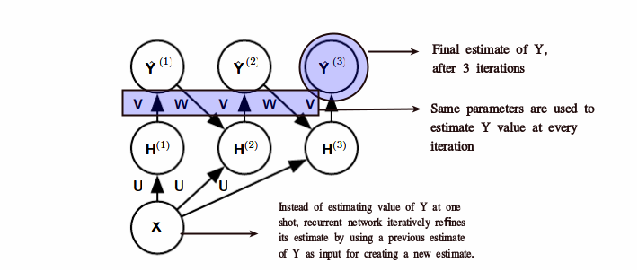

Slide 79
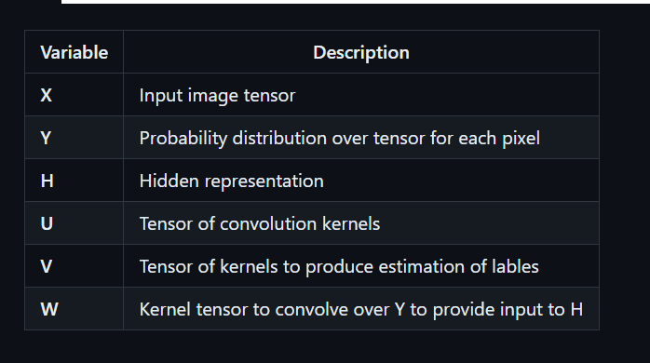

Slide 80
DATATYPES
The data used with a convolutional network usually consist of several channels,each channel being the observation of a diﬀerent quantity at some point in space or time.
When output is variable sized, no extra design change needs to be made.
When output requires fixed size (classification), a pooling stage with kernel size proportional to input size needs to be used.

Slide 81
For CNNs, the data used usually has several channels (single channel or multichannel) with different dimensionalities (1-D, 2-D, or 3-D). Each of these channels represent an observation of a different quantity at some point in space or time.

Slide 82
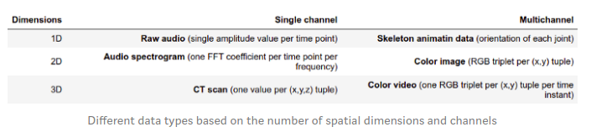

Slide 83
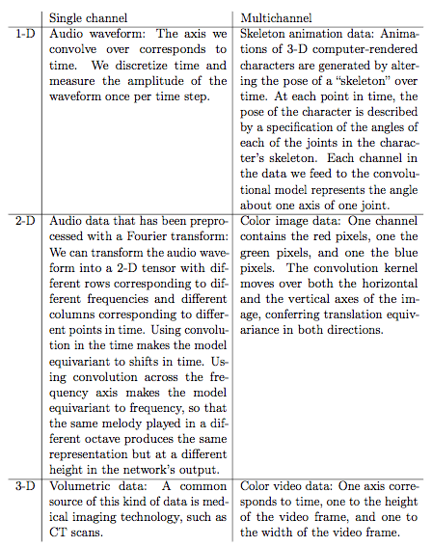

Slide 84
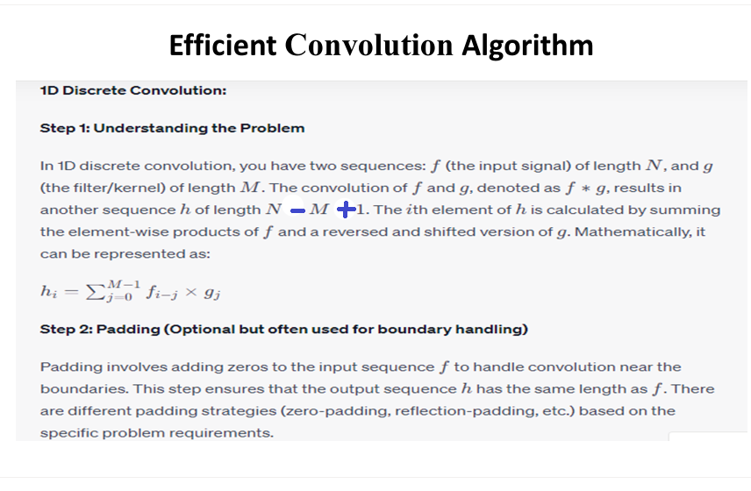

Slide 85
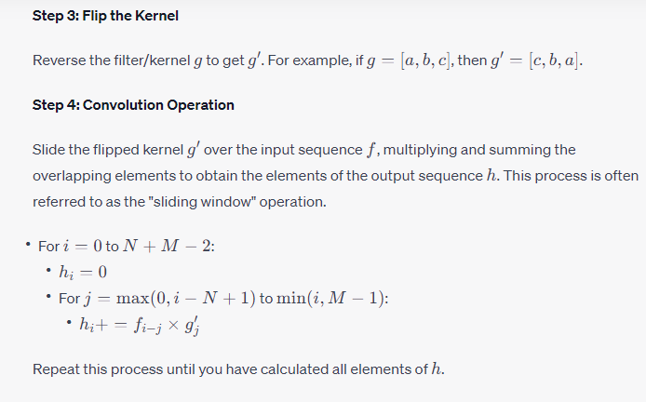
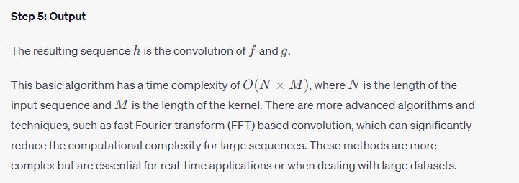

Slide 86
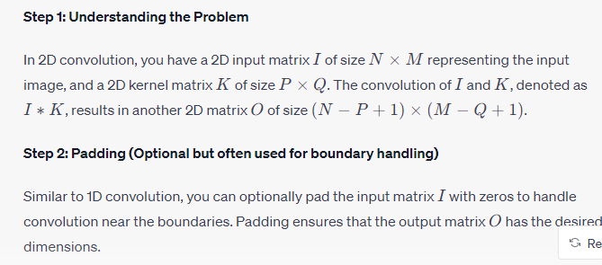
2D convolution is a fundamental operation in image processing and computer vision. It involves convolving a 2D input image matrix with a 2D kernel (also known as a filter or mask) to produce a 2D output image. The convolution operation is used for various tasks such as edge detection, blurring, sharpening, and feature extraction in images.

Slide 87
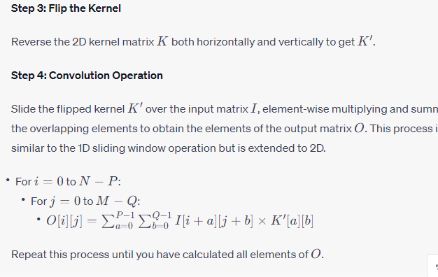
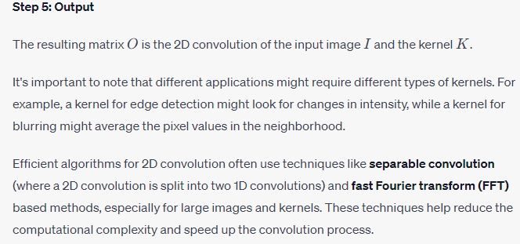

Slide 88
Applications of Convolutional Neural Networks

Slide 89
Convolutional Neural Networks (CNNs) excel in image and video analysis tasks due to their hierarchical feature extraction. They find applications in image recognition, object detection, facial recognition, medical image analysis, self-driving cars, and more. CNNs leverage their convolutional and pooling layers to automatically learn relevant features, making them pivotal in visual data processing tasks.

Slide 90
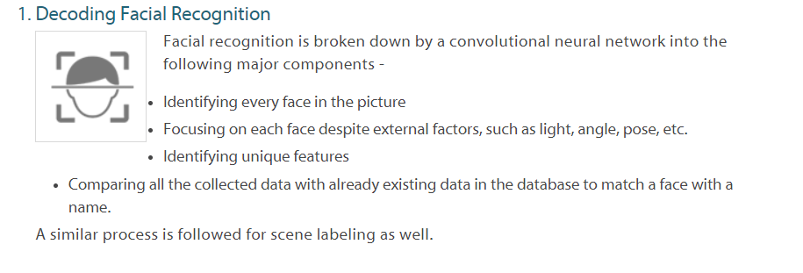

Slide 91
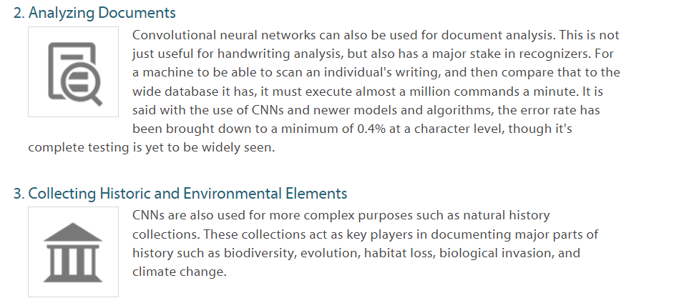

Slide 92
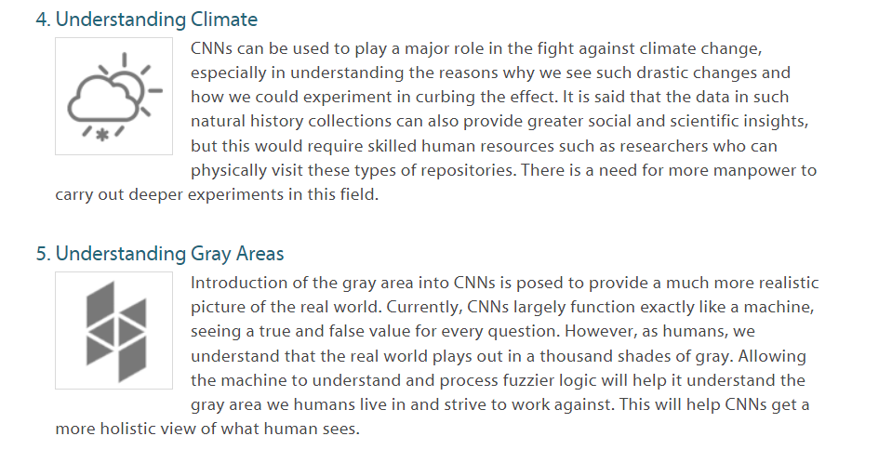

Slide 93
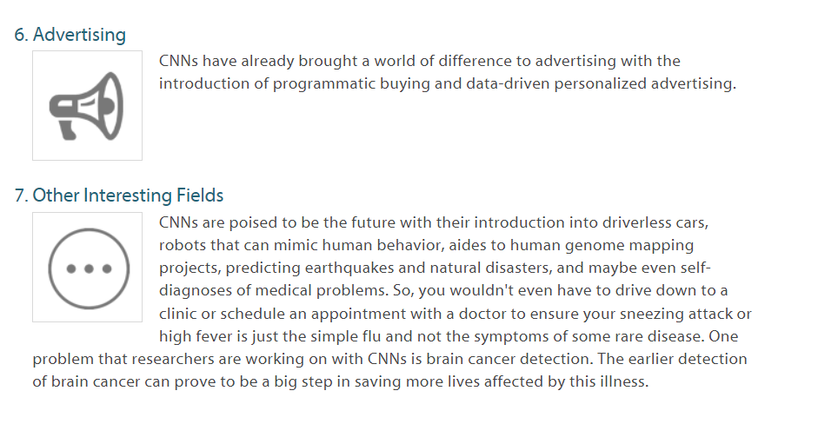

Slide 94
Image Classification – Search Engines, Social Media, Recommender Systems
The major use of convolutional neural networks is image recognition and classification.
The CNN picture categorization serves the following purposes:
🡪Deconstruct an image and find its distinguishing feature. The system employs a supervised machine learning classification algorithm for this purpose.
🡪Reduces the description of its important credentials. It’s done with the help of an unsupervised machine learning algorithm.
This method is used in the following fields:
Image tagging
The most basic type of image classification algorithm is image tagging. The image tag is a term or a phrase that describes the images and makes them easier to find. This method is used by big companies like Facebook, Google, and Amazon. It is also one of the fundamental elements of visual search. Tagging involves recognition of objects and even sentiment analysis of the image tone.
Visual Search
This method involves comparing an input image to the access database. Furthermore, the visual search evaluates the image and searches for other photos that have comparable credentials.

Slide 95
Medical Image Computing – Predictive Analytics, Healthcare Data Science
The most fascinating image recognition CNN use case is medical image computing.
The medical image includes a whole lot of further data analysis that arises from initial image recognition.
CNN medical image classification detects anomalies in X-ray and MRI images with better accuracy than the human eye.
These systems can display the series of photos as well as the differences between them. This feature lays the groundwork for future predictive analytics.
Medical image classification is based on massive datasets such as Public Health Records.
It serves as a training basis for the algorithms and patients’ confidential data and test results.
They work together to create an analytical platform that monitors the current status of the patient and forecasts results.

Slide 96
Health Risk Assessment Using Predictive Analytics
In healthcare, saving lives is a top priority. And it is always advantageous to have the ability to predict the future. Because when it comes to patient care, you must be prepared for anything. The health risk assessment is an excellent demonstration.
Convolutional Neural Network Predictive Analytics is used in this field.
Here’s how CNN Health Risk Assessment works:
CNN uses a grid topology approach to process data, which is a set of spatial correlations between data points.
The grid is two-dimensional in the case of images.
The grid is one-dimensional in the case of time series textual data.
The convolution algorithm is then used to identify some aspects of the input.
Take into account the variations of input.
Determine variable interactions.

Slide 97
Drug Discovery Using Predictive Analytics
The problem is that drug discovery and development is a time-consuming and costly process. In drug discovery, scalability and cost-effectiveness are critical.
The process of developing new drugs lends itself well to the implementation of neural networks. During the development of a new drug, there is a large amount of data to consider.
The following stages are involved in the drug discovery process:
--This is a clustering and classification problem involving the analysis of observed medical effects.
--Machine learning anomaly detection may be useful in hit discovery.
--The algorithm searches the compound database for new activities that can be used for specific purposes.
--Then, using the Hit to Lead process, the results are narrowed down to the most relevant.
-- That’s what dimensionality reduction and regression are all about.
--Then there’s Lead Optimization, which is the process of combining and testing lead compounds to find the best approaches to them.
--The stages involve the examination of the organism’s chemical and physical effects.

Slide 98


